Slide 1
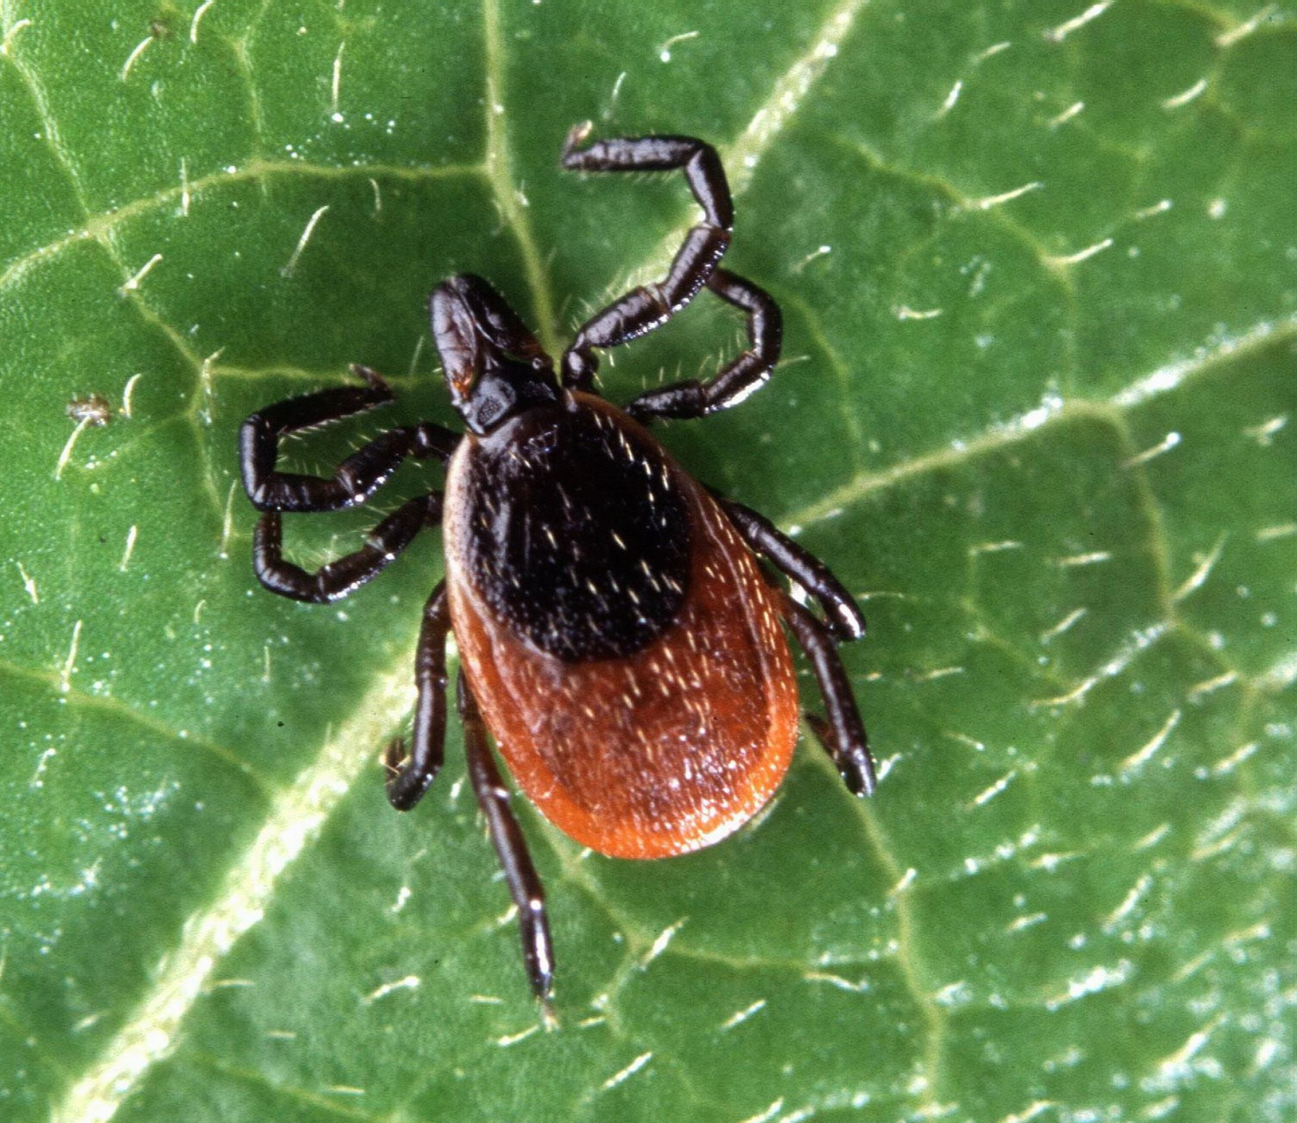
Ticks in the Midwest
Cassidy Kohls & Matthew Voss

Slide 2
Table of Contents
3 Introduction
4 Data Source
5 Descriptive Summary
6 Methods
7 Summary of Results
9 Outcome
10 Next Steps
11 References

Slide 3
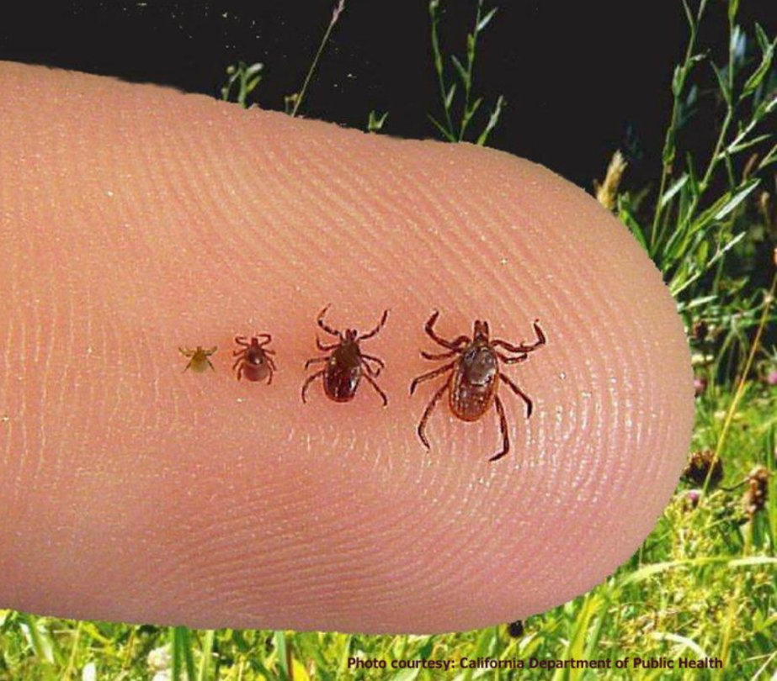
Introduction
Immature blacklegged ticks spread Lyme disease
Tough to spot
30,000 Lyme disease cases are reported
Estimated 476,000 people contract the diseases
Inspired to build a model to predict the spread of blacklegged ticks
Help control and prevent the infectious disease
Model: identify which counties within the Midwest are vulnerable to ticks

Slide 4
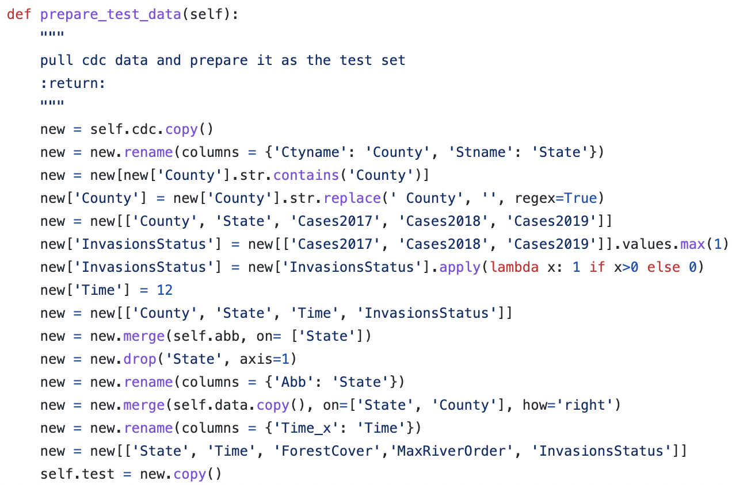
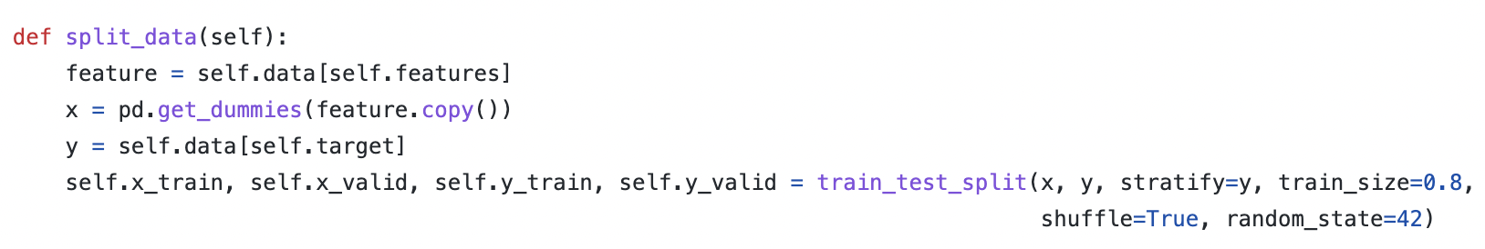
Data Source
Midwest Lyme Invasion Data
Developed by scientists affiliated with the University of Illinois at Urbana-Champaign
Used secondary data such as historical information from local health department reports to build their data set
CDC Lyme Disease Data
Documents the number of Lyme disease cases over the years through secondary data from state and local health departments
Test data set

Slide 5
Descriptive Summary
Dependent Variable:
Independent Variables:
GitHub
Variable | Mean | Median | Standard Deviation
Invasion Status | 0.65 | 1 | 0.477
State | - | - | -
Time | 7.858 | 8 | 2.002
ForestCover | 20.53 | 12.14 | 19.65
MaxRiverOrder | 5.76 | 5 | 1.47
PosCounty | 0.41 | 0 | 0.49

Slide 6
Methods
Logistic Regression
The data was binary, so we used it to classify whether black-legged ticks were present (1) or not (0)
Histogram Gradient Boost
A decision tree that allows for various types of loss functions. Considered a weak learner.
Random Forest Classifier
A decision tree that bootstraps the features and samples to maximize accuracy
Cluster Analysis
Can help identify if certain geographical areas are linked with high level
$Ln\left(\frac{InvasionStatus}{1−InvasionStatus}\right)$ = $−0.46+\left(−0.06 x Time\right)+\left(0.04 x ForestCover\right)+\left(0.07 x MaxRiverOrder\right)+(0.62 x PosCounty)$ $+\left(0.63 x StateIA\right)$ $+ \left(−0.54 x StateIL\right)$ $+ \left(0.25 x StateIN\right)$ $+ \left(−0.40 x StateMI\right)$ $+ \left(0.34 x StateMN\right)$ $+ \left(0.48 x StateND\right)$ $+ \left(−1.57 x StateNE\right)$ $+ \left(−0. 63 x StateOH\right)$ $+ \left(0.11 x StateSD\right)$ $\left(1.32 x StateWI\right)$
𝐿𝑛(𝐼𝑛𝑣𝑎𝑠𝑖𝑜𝑛𝑆𝑡𝑎𝑡𝑢𝑠/(1−𝐼𝑛𝑣𝑎𝑠𝑖𝑜𝑛𝑆𝑡𝑎𝑡𝑢𝑠)) = −0.46+(−0.06 x Time)+(0.04 x ForestCover)+(0.07 x MaxRiverOrder)+(0.62 x PosCounty) +(0.63 x State𝐼𝐴) + (−0.54 x State𝐼𝐿) + (0.25 x State𝐼𝑁) + (−0.40 x State𝑀𝐼) + (0.34 x State𝑀𝑁) + (0.48 x State𝑁𝐷) + (−1.57 x State𝑁𝐸) + (−0. 63 x State𝑂𝐻) + (0.11 x State𝑆𝐷) (1.32 x State𝑊𝐼)
Notes:
array([[-0.06, 0.04, 0.07, 0.62, 0.63,
-0.54, 0.25, -0.40, 0.34, 0.48 ,
-1.57, -0.63, 0.11 , 1.32]])
Index(['Time', 'ForestCover', 'MaxRiverOrder', 'PosCounty', 'State_IA',
'State_IL', 'State_IN', 'State_MI', 'State_MN', 'State_ND', 'State_NE',
'State_OH', 'State_SD', 'State_WI'],
dtype='object’)
estimator.intercept_
array([-0.45678708])

Slide 7
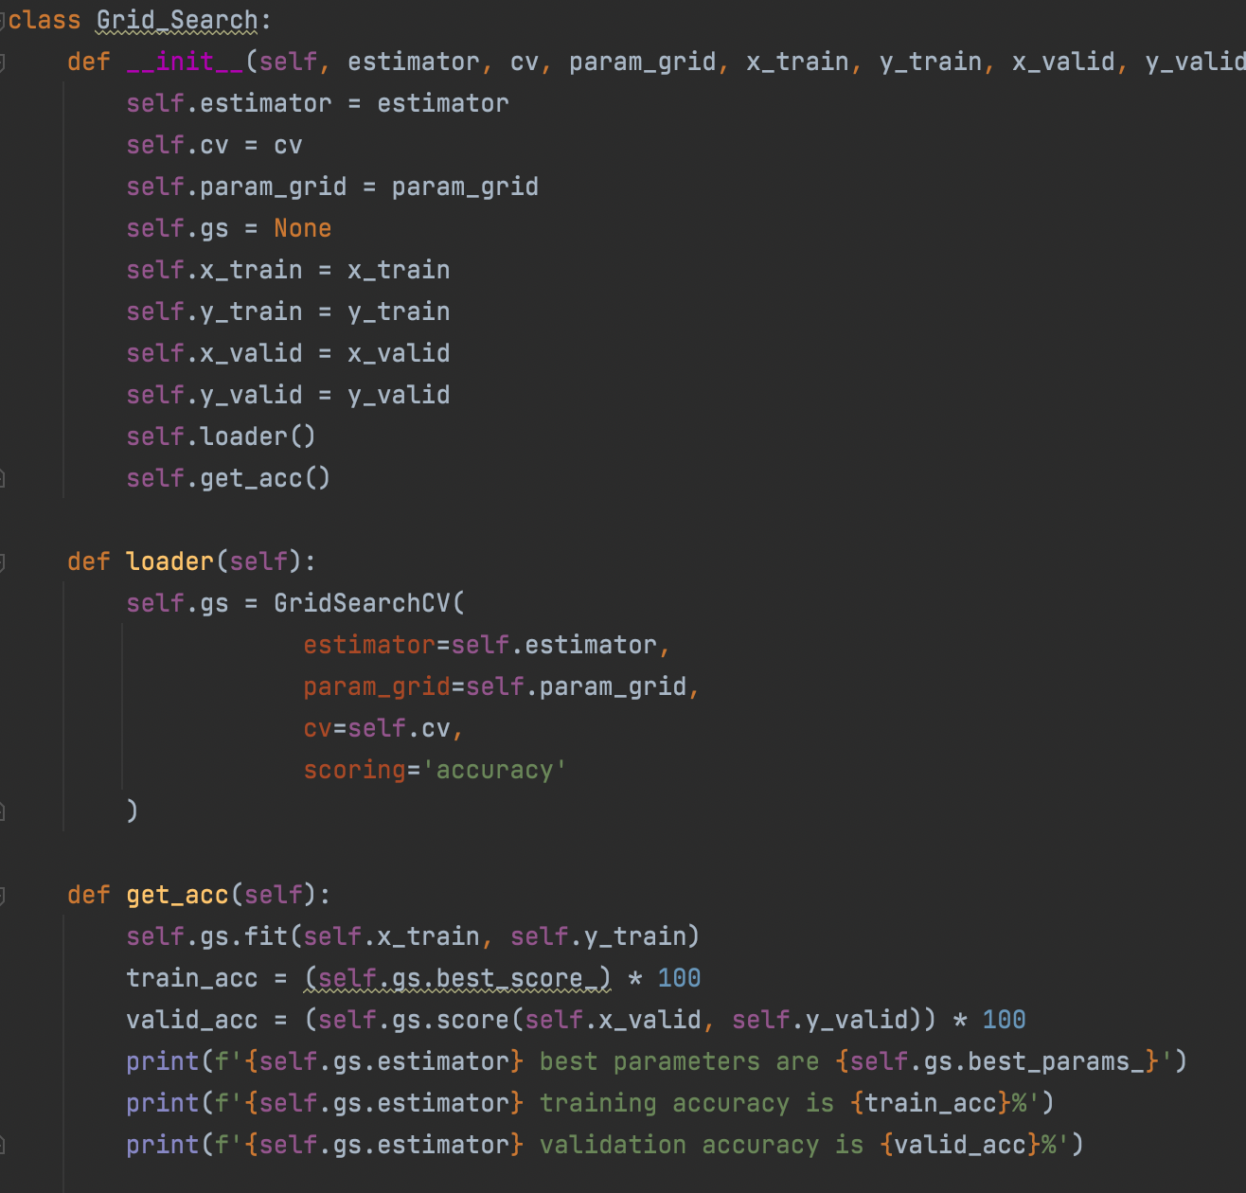
Summary of Results
Using the Grid Search Class, we specified our 10 k-fold
Logistic Regression has 74.8% accuracy
Histogram Gradient Boost has 74.78% accuracy
Random Forest Classifier has 74% accuracy

Slide 8
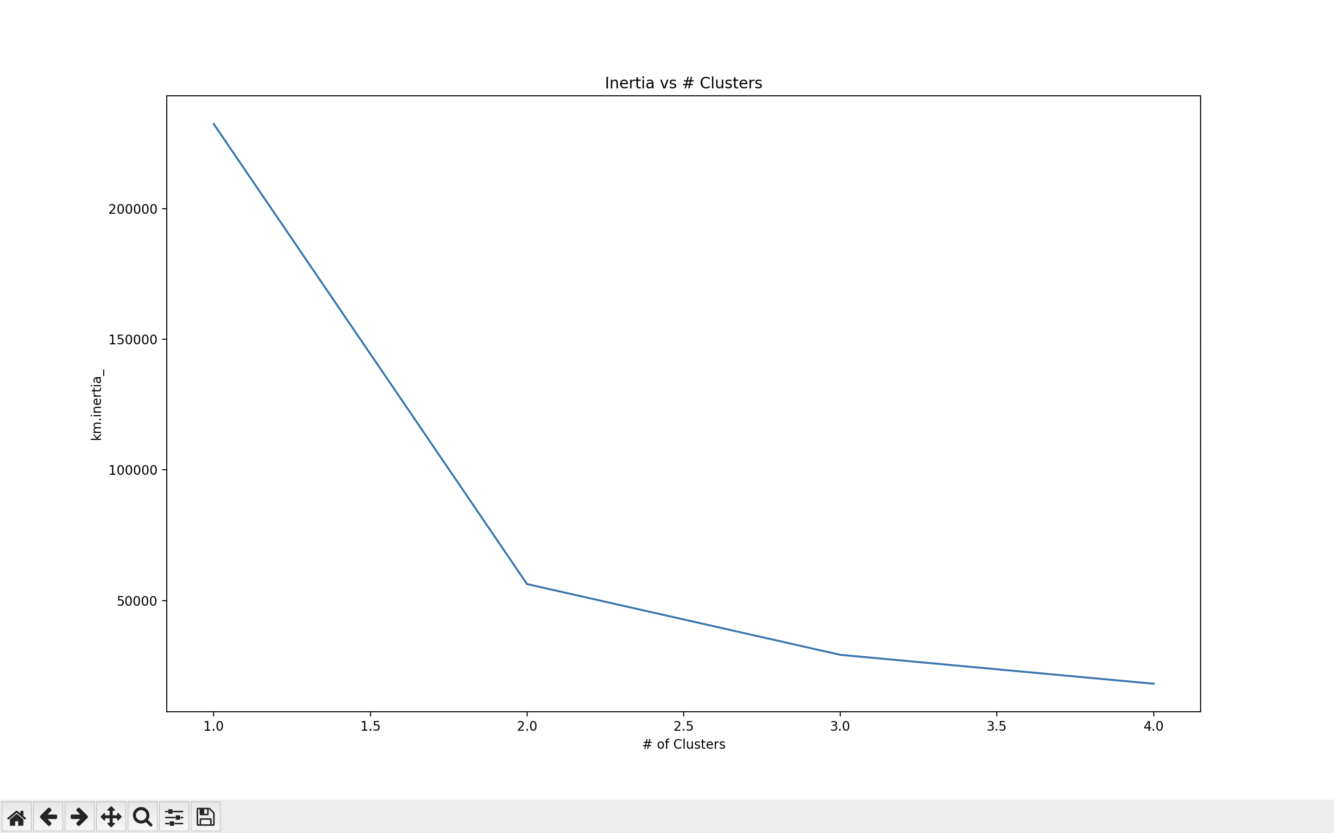
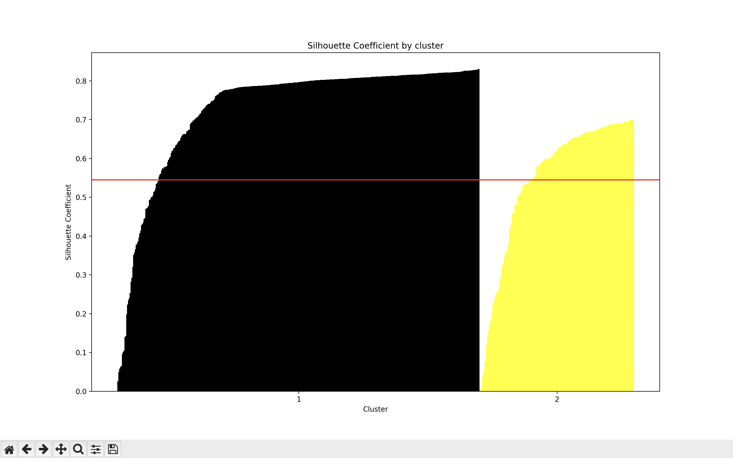
Cluster Analysis and Silhouette Plots

Slide 9

Outcome
Poor performance while training a few machine learning models
Decided to use the random forest classifier method for our model
Model performed poorly with a test accuracy of 74%
Prediction accuracy fell short
We could not aid individuals or authorities in detecting the disease early or give them the ability to make better-informed decisions
“Nearly nine out of ten data science projects never make it to production” ~(VentureBeat,2019)

Slide 10
Next Steps
Combing through the LymeDisease Class and located the bug
Fixing the scalar
Collecting additional data on variables such as:
Temperature
Tick carrier migration within deer and other animals
Data on all counties for each time period
Recommend using RStudio instead of Python due to the data sets small size
Python offers a more developed suite of libraries to use for machine learning
Overall, more data would greatly improve the accuracy of our models

Slide 11
References
Allan, B., & Gardner, A. (2020). Gardner Midwest Lyme invasion data 2020-11-18 [Data set]. University of Illinois at Urbana-Champaign. https://doi.org/10.13012/B2IDB-6050723_V2
Allan, B., Gardner, A., Hamer, S., Hickling, G., Miller, J., Pawlikowski, N., Schotthoefer, A., & Tsao, J. (2020). Landscape features predict the current and forecast the future geographic spread of Lyme disease. The Royal Society Publishing, 287(1941), 1-10. https://doi.org/10.1098/rspb.2020.2278
PyTorch. (n.d.) LSTM. https://pytorch.org/docs/stable/generated/torch.nn.LSTM.html
U.S. Center for Disease Control and Prevention. (2019). County-level Lyme disease data from 2000-2019 [Data set]. https://www.cdc.gov/lyme/resources/datasurveillance/LD-Case-Counts-by-County-00-19.csv
U.S. Center for Disease Control and Prevention. (n.d). Data and surveillance. https://www.cdc.gov/lyme/datasurveillance/index.html#:~:text=Standard%20national%20surveillance%20is%20only,year%20in%20the%20United%20States

Slide 12

Thank you!

